Slide 1
Regression analysis

Slide 2


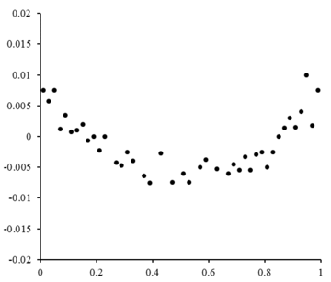
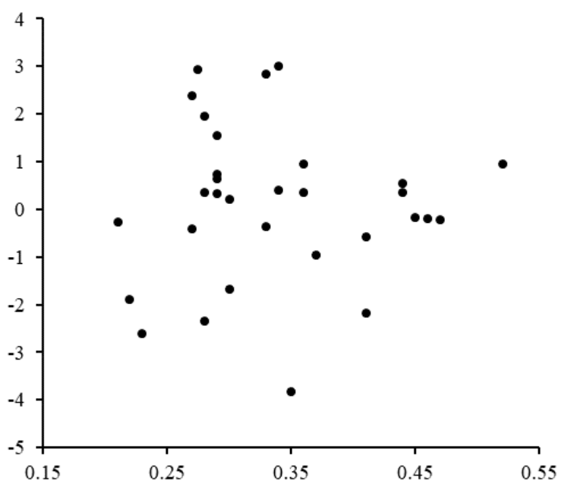
least squares
Assume a simple data set consists of n points as pair (x,y)
Where x denotes independent vector variable and y dependent variable
The least square method finds the optimal parameter values by minimizing the sum, S of squared residuals
Residual plots

Slide 3
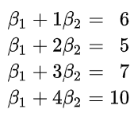
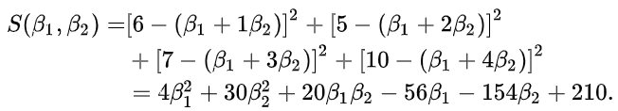
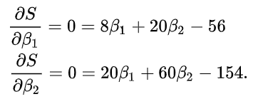
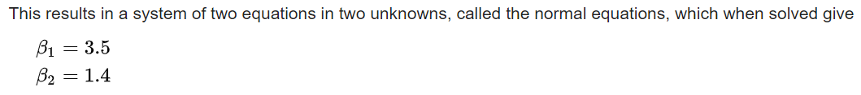
Linear least squares
Consider 4 data points – (1,6), (2,5),(3,7) and (4,10)
We hope to find a line y = b1 + b2 x that best fits these four points
So we want to solve overdetermined linear system

Slide 4
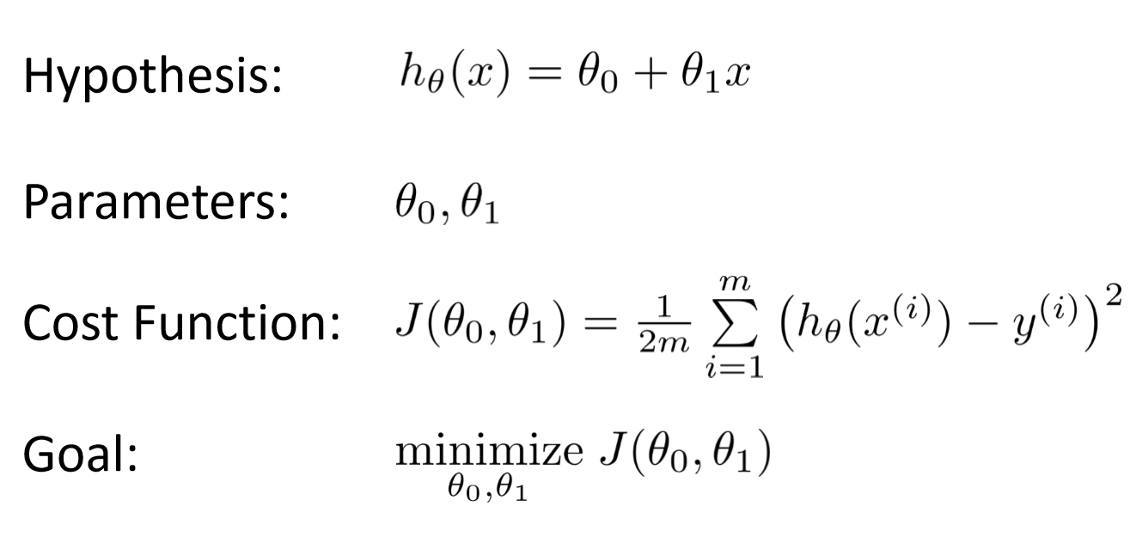
Linear regression

Slide 5
Linear regression
Method
Iterative vs non-iterative
Iterative
Gradient descent, stochastic gradient descent

Slide 6






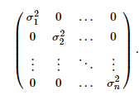
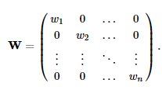




Linear Regression
OLS
Parameters equal variances & uncorrelated
Errors are uncorrelated and follows gaussian , white noise(homoscedasticity)
Weighted Least square –errors are independent but not identically distributed

Slide 7
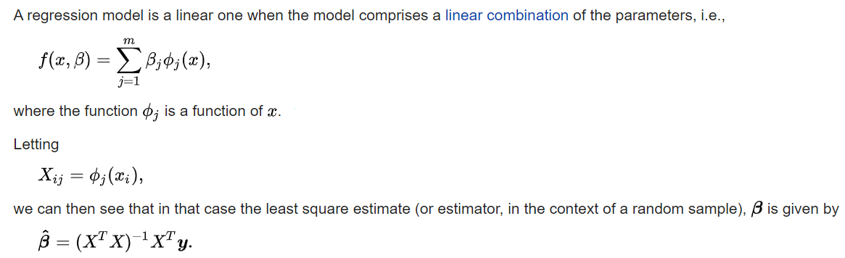


Contd..
Linear term in linear least sq refers to model coefficient betas
It means we could apply the same linear least squares method for quadratic model
Solve using least square for the model
This is the OLS method which is also a closed form expression.
is Moore-Penrose inverse

Slide 8



Contd..
Generalized least square method is an extension of OLS method to cater for heteroscadacity and/or correlation
GLS –
Where is the covariance matrix of errors
If only heteroscadacity is present then weighted least squares can be used
For homoscadisticity
For heteroscadacity

Slide 9
Contd..
Consider the following data. We want to model sales = f(advertisement)
Sales (m USD) | 651 | 762 | 856 | 1063 | 1190 | 1298 | 1421
Advertising (m USD) | 23 | 26 | 30 | 34 | 43 | 48 | 52

Slide 10

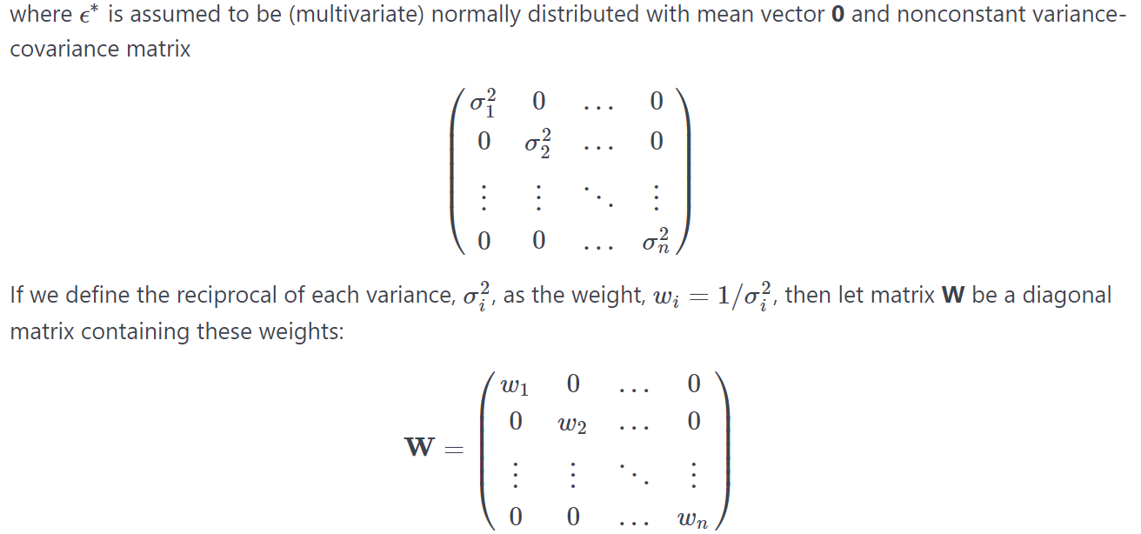
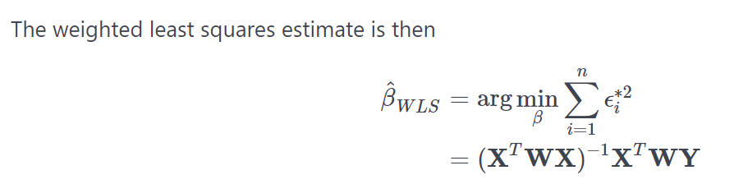
Weighted least squares
OLS assume there is a constant variance for errors (homoscadacity)
Original model is

Slide 11

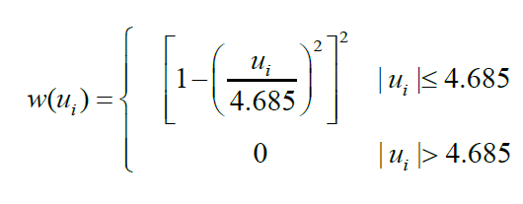


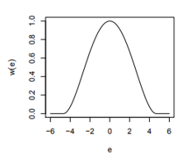
Robust Regression
A more useful weight function of WLS can help in handling outliers better

Slide 12
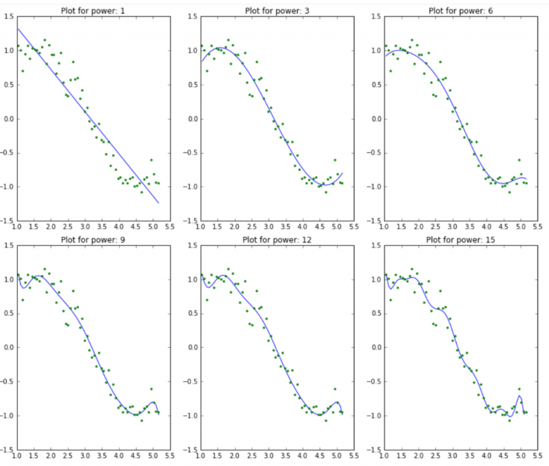
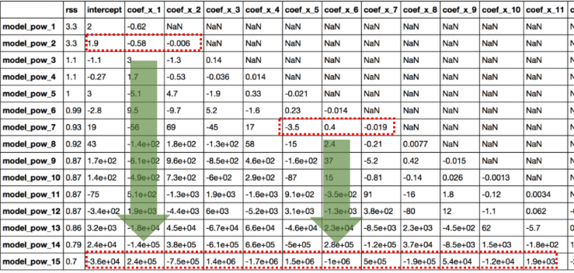
Ridge Regression

Slide 13
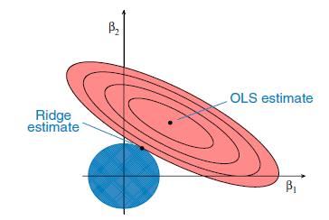
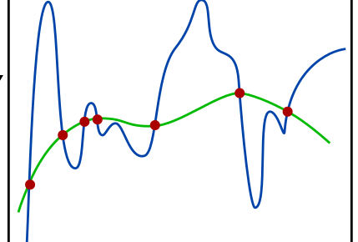



Ridge Regression
The problem can be ill posed depending on the matrix X

Slide 14
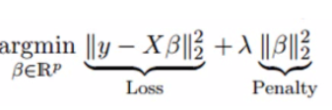


Handling multicollinearity in linear regression
Ridge regression
Lasso regression
ElasticNet regression

Slide 15
Linear regression exercise
For the following data
Do a OLS, weighted least square, robust regression, ridge and Lasso using excel

Slide 16
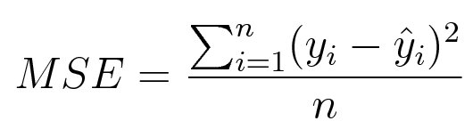

Linear regression gradient descent- exercise
Consider the following data. We want to model sales = f(advertisement)
Linear regression with gradient descent
Assume your linear model y = wx + b
Use the L2 norm loss function where loss is
Consider the gradient descent rule
Write a gradient descent function which will use w, b, x and number of iteration and will return the final value of w and b
Note in each iteration
w = w + delta w, and b = b + delta b
Modify the above function to include the learning rate in the gradient descent function
Sales (m USD) | 651 | 762 | 856 | 1063 | 1190 | 1298 | 1421
Advertising (m USD) | 23 | 26 | 30 | 34 | 43 | 48 | 52

Slide 17
Linear regression with real world data – ex1
Download Boston real estate database
from sklearn.datasets import load_boston
data = load_boston()
Check all the dictionary keys for this DB
Load the DB into a pandas data frame including the target column
Do some simple descriptive stat
Check how many n/a in each column
Check the histogram plot for each variables including target
Check the correlation matrix using sns heat map
What is your observation about multicollinearity
Select a small number of features (best 2) that has highest correlation with target
Use scatter plot for those two features to show their relationship with target
Create an input data matrix from the above data frame that has only those two features , along with their names
Create the output data matrix

Slide 18
Contd..
Split data into train test (80-20)
from sklearn.model_selection import train_test_split
X_train, X_test, Y_train, Y_test = train_test_split(X, Y, test_size = 0.2, random_state=5)
Using sklearn LinearRegression and your choice of loss function
Train, test and evaluate the model

